Slide 1
Assignment 2: The Struggle of the Hand Built MODFLOW Box Model
Group Leads: Quinn Hull and Gillian Noonan
January 26, 2021

Slide 2
Outline
The Challenge
How are we feeling about MODFLOW right now?
The 'Conceptual' Box Model
The 'Key' Figures
Technical Struggle Share and Care
The Challenge Questions
Breakout Groups
Regroup

Slide 3
The Challenge
Overview:
MODFLOW files were supplied that model steady state saturated flow through a 3D system for a homogeneous medium.
Challenge(s):
Run a MODFLOW model from the command line for the homogenous case.
Modify the text input files to run a model for a heterogeneous case (low k zone located in series across flow path).
Modify the text input files to run a model for a homogeneous case with a centered inclusion of low hydraulic conductivity (K).

Slide 4
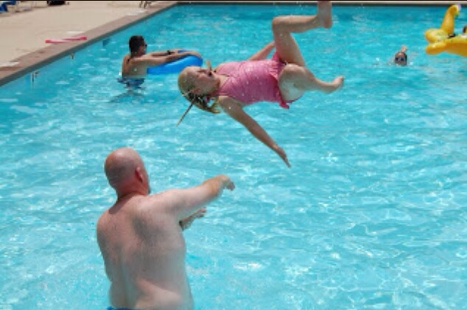
How are we feeling right now?
Me
Hand-Built
MODFLOW
Ty
Notes:
@Gillian – an opportunity to talk about the struggle being real. Make sure that we have room for solidarity

Slide 5
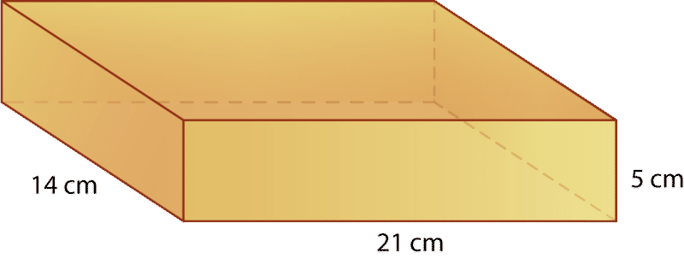
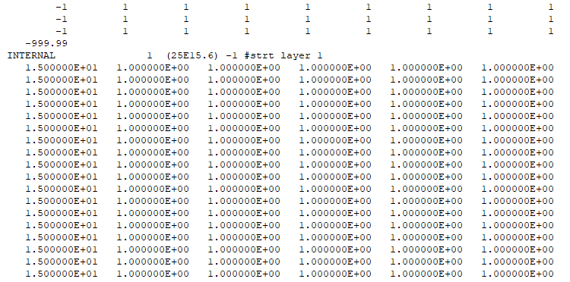
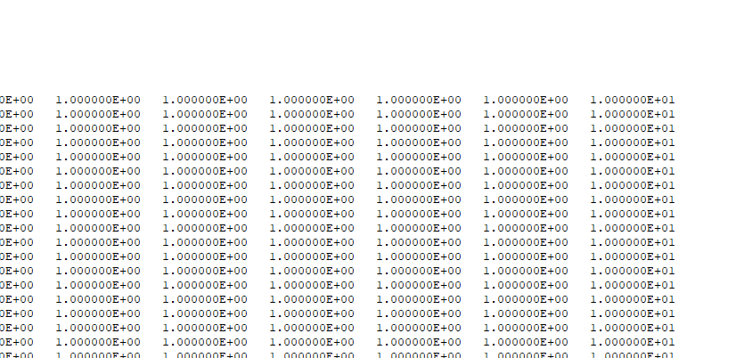
The Conceptual Model – Model 1
Homogeneous
Given:
Flat lying
Top and bottom and two opposite vert. boundaries are no flow
Each of other faces has constant head
How did you enter this into your model?
No Flow
15 m
10m
Flow out
Flow in
Where is this entered into the model?
2400 m
100 m
2500 m
Base (BAS) file -
Starting head model identified

Slide 6
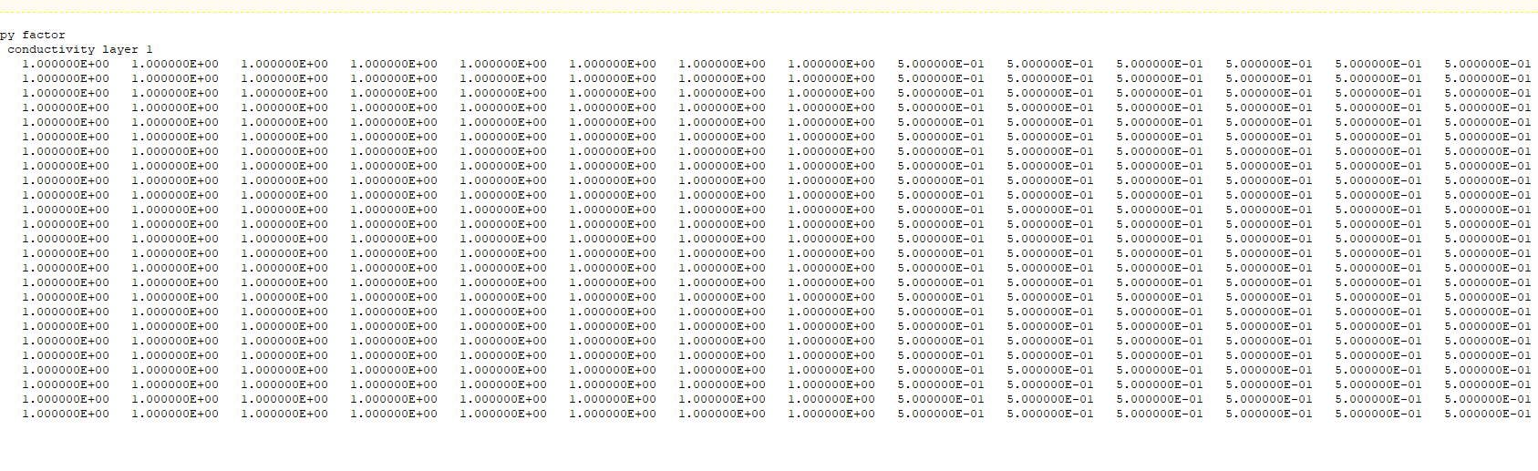
The Conceptual Model – Model 2
Heterogeneous
Given:
Zoned, heterogeneous domain
Left half is 1 m/d
Right half is 0.5 m/d
15m
10m
Flow out
Flow in
Low K
2400 m
100 m
How did you enter this into your model?
2500 m
1
0.5
Block Centered Flow Package (.bcf)
is used to specify properties controlling flow between cells

Slide 7
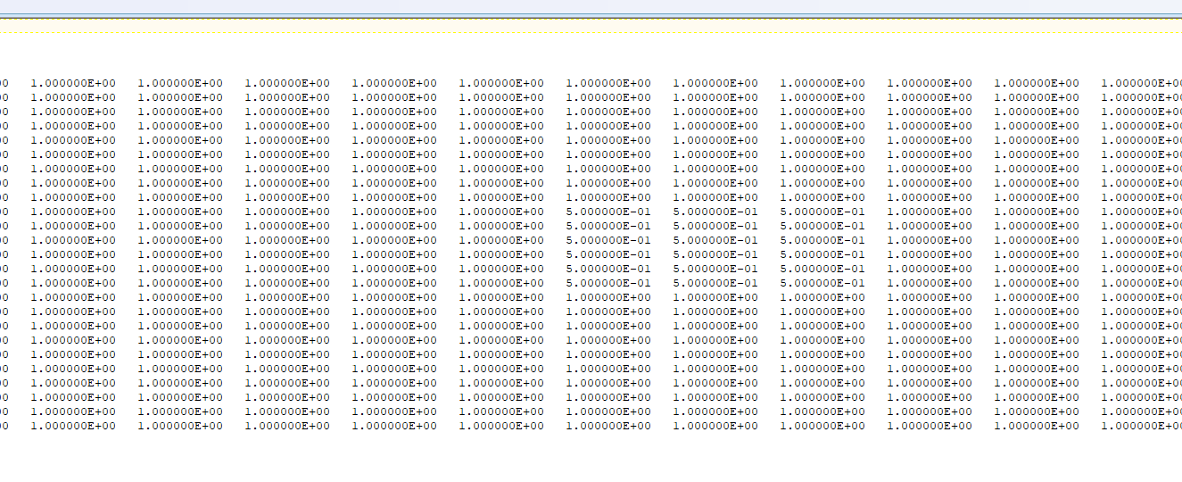
The Conceptual Model – Model 3 Homogeneous with Inclusion
Given:
Homogeneous domain with a low K inclusion in rows 11-15 and columns 11-15
Background is 1 m/d
Inclusion is 0.5 m/d
15m
10m
Flow out
Flow in
Low K
2400 m
100 m
How did you enter this into your model?
2500 m
Block Centered Flow Package (.bcf)
is used to specify properties controlling flow between cells

Slide 8
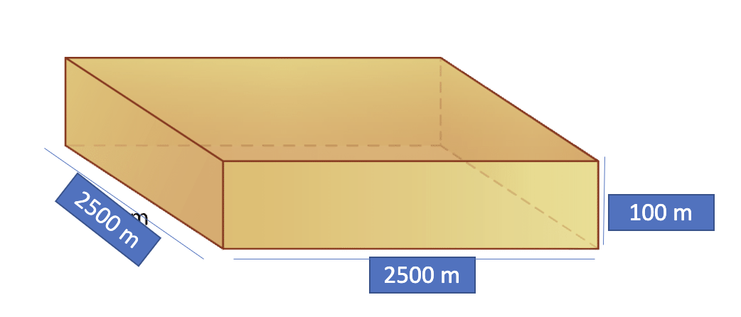
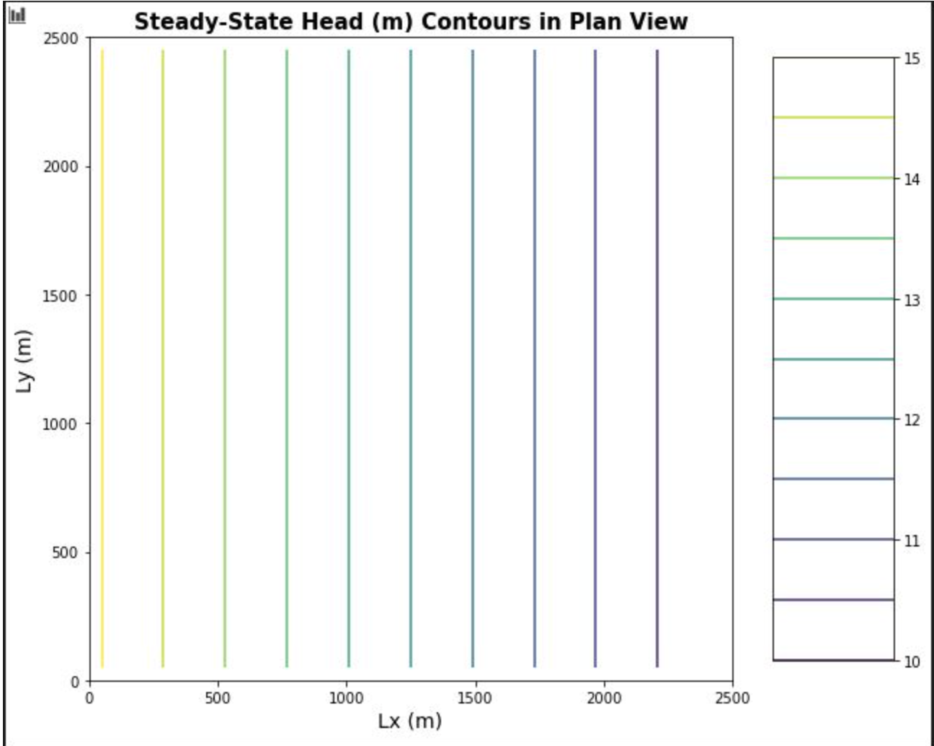
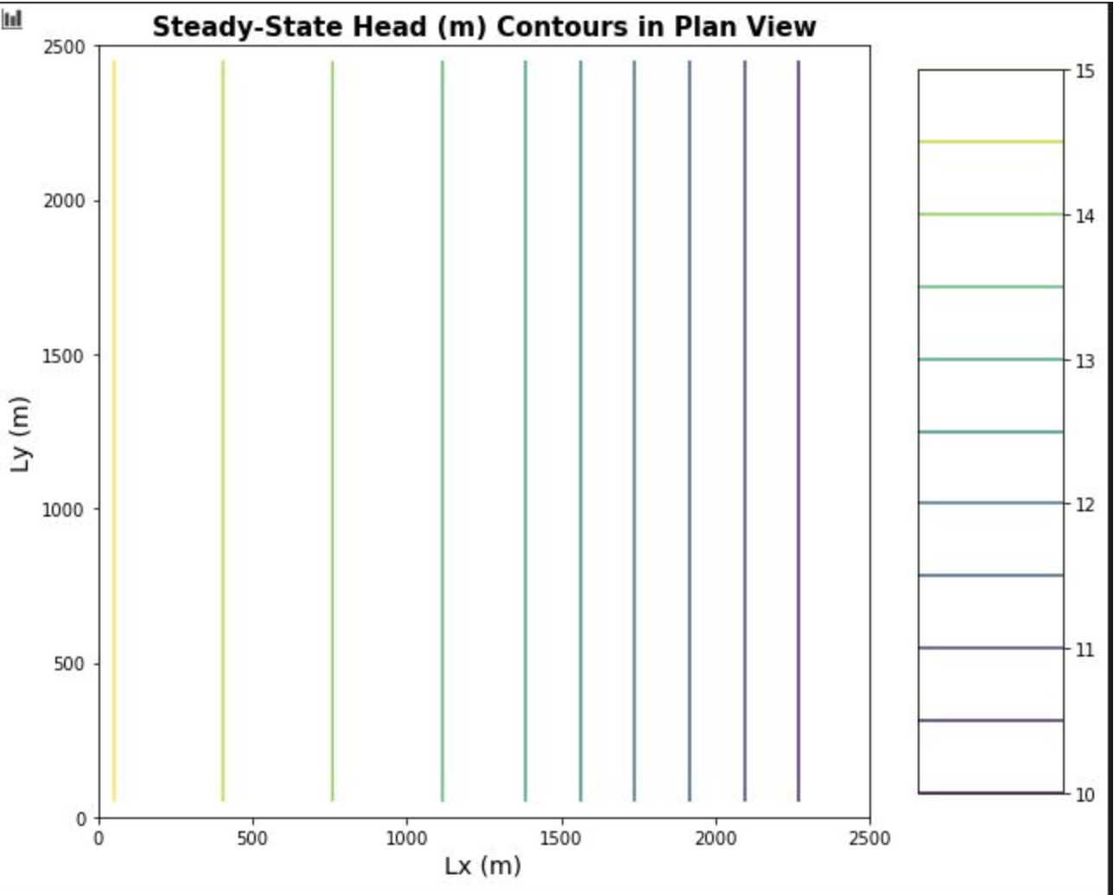
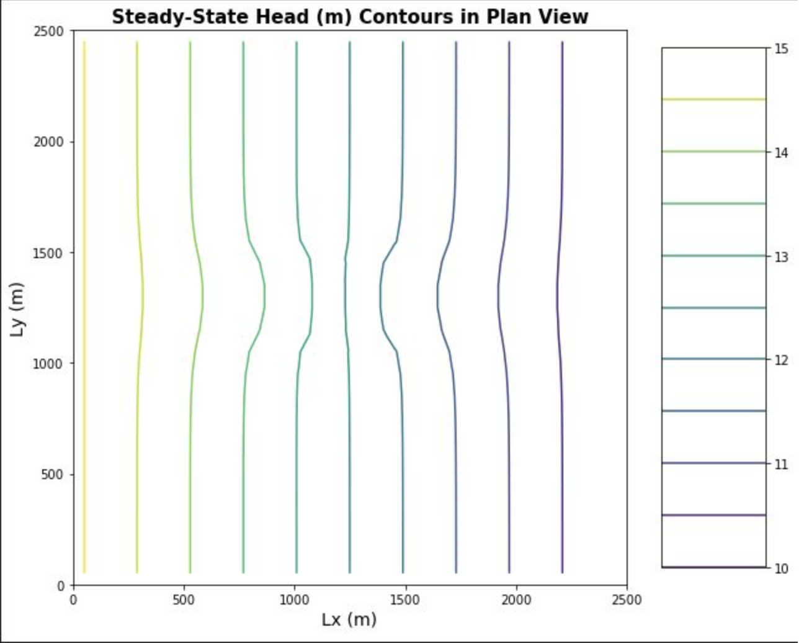
The Key Figures
Low K zone
Low K zone
Notes:
QH: We can see the relationship between the structure and the head lines in plan view
QH: But how did we make those figures?

Slide 9
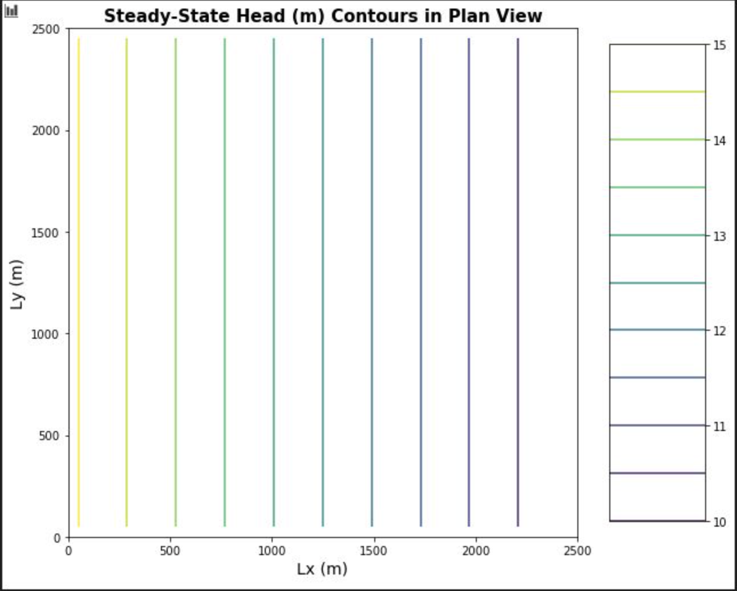


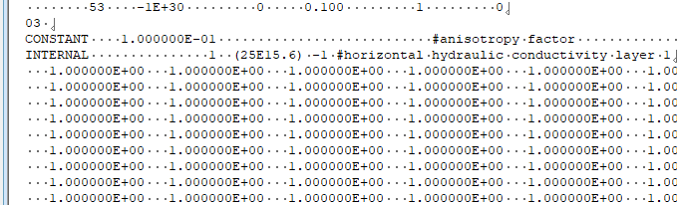
Technical Struggle Share and Care
This went wrong for us
Quinn –
Mac and MODFLOW interoperability
Excel Figures
Jill –
Formatting of text files (# spaces, number formatting)
Excel Figures
What went wrong for you?
Having list file update correctly
Excel Figures
Confused about Dimensions
Breakout Help Room - Coming Up! (Room 1)
Notes:
@Gillian – a (brief) opportunity to talk about our techincal struggles

Slide 10
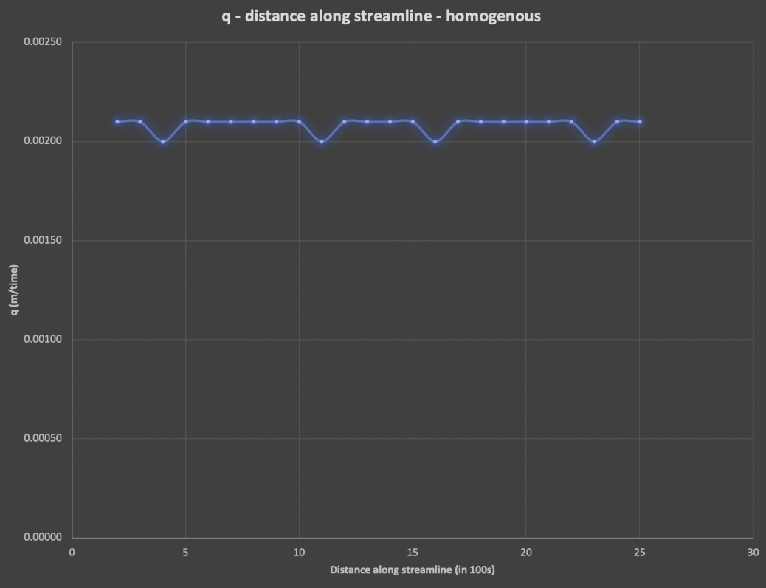
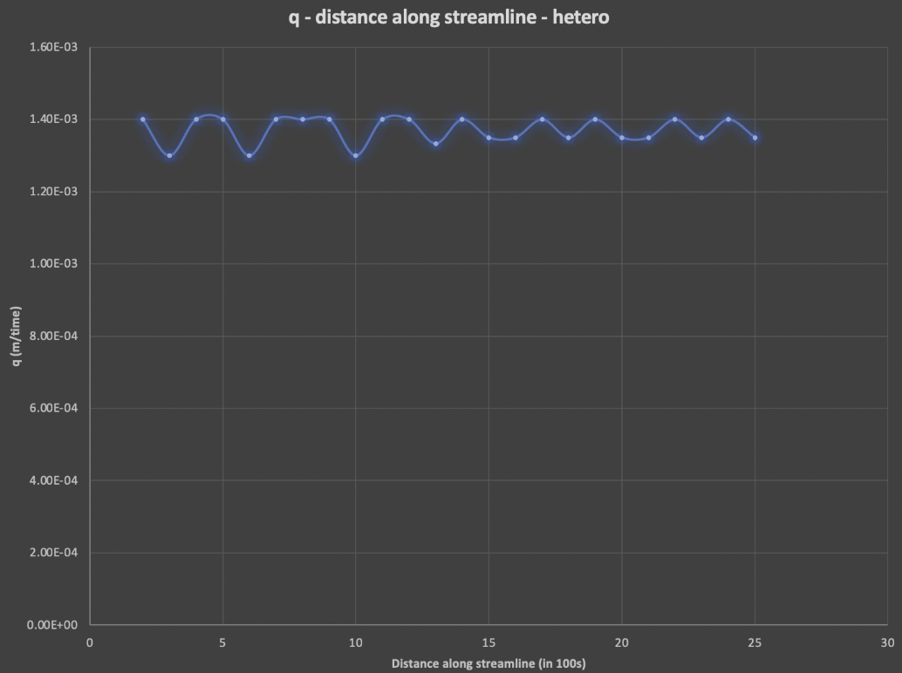
Challenge Question (1)
1. Show, based on the flux with horizontal distance from a constant head boundary, that the model is steady state.
A) Homogenous
B) Heterogenous
From the previous assignment, we know that for 1-D flow flux will be constant along a flux path. No change in storage anywhere.
Show that flux is unchanging with distance.
How did you account for the fact that the heads are calculated in the center of the cell (node) and the K values are defined over each cell?
Flow
Flow
Breakout Room Topic - Coming Up! (Room 2)

Slide 11
Challenge Question (2)
2a. Show the steady state head contour in plan view for the heterogeneous (zones in series) condition.
Use this plot to defend a contention that flow is 1D.
Flow Lines
Flow paths will trace perpendicular to head distribution contours

Slide 12
Challenge Question (2)
Higher gradient, low k zone
2b. Use the results to explain WHY the equivalent hydraulic conductivity, Keq, is closer to the lower of the two K values.
Key Concepts:
From Darcy: we know that we have a certain amount of energy to dispel through a system. Here we are requiring same flow through whole system due to steady state conditions.
Keq is controlled by the layer where more energy is used to move through that layer.
The energy is related to the square of the gradient. Therefore the energy loss is larger in the low k medium, which has a higher gradient.
In our model, we are forcing the energy through the low K area where it is losing a lot of energy.
"The system is most sensitive where the most energy is lost". – Ty Ferre
Breakout Room Topic - Coming Up! (Room 3)

Slide 13
Challenge Question (3)
3a. What can you learn based on your explanation of what controls the effective K for a 1D flow system now that you are applying it to a 2D system?
a. The 2D flow system matches our intuition about energy and K.
The gradient is steeper in lo-K inclusion
i.e. greater energy loss relative to the Hi-K media around it

Slide 14
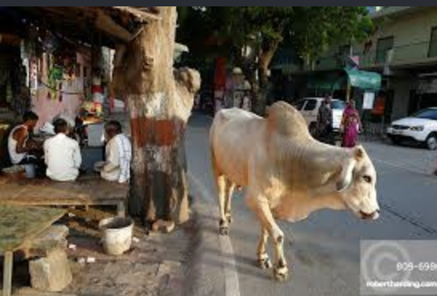
Challenge Question (3)
3b. What do you think the Keq of this entire system would be compared to the high and low K values?
b. One critical difference between the 1-D and 2-D problem is that flow is traveling in both the x and y directions now.
An intuitive way of thinking about this is that the flow attempts to avoid (as best possible) the low-K obstruction in the middle
We aren't sure what the Keq value would be, but it is likely to be closer to the high K zone than to the low K zone.

Slide 15
Challenge Question (3)
3c. Explain why it is much more difficult to develop a direct solution for this 2D system than it was for a 1D system (including the zones placed in series).
Because the flow paths are no longer 1D interplay of flow paths and the structure of hydraulic conductivity (aka K distribution) makes this problem hard to solve.
* note: the flow PATHS themselves depend on the K distribution
Let's think about this question in the breakouts
Breakout Room Topic - Coming Up! (Room 4)

Slide 16
Break-out Rooms
Room 1: Technical Struggles Help Group
Room 2: What is the form of the equation used to calculate q for each cell in a 2D model (from Challenge Question 1)? How code it into excel (or other platform)? Were you able to show 'steady state' in your figure? Why or why not?
Room 3: Explain why Keq in Case 2 is closer to the low-K value, but cannot be calculated in the same way in the 2-D flow model (Case 3). Explain this in terms of energy and flow paths.
Bonus1: How might we calculate Keq in the 2-D flow model (Case 3)?
Bonus2: How would the 2-D flow model (Case 3) look with a Hi-K inclusion?
* Hint: Look at GitHub article for more info: https://github.com/GW-modelling-Spring2021/Course_Materials/blob/main/Assignments/HW1_BoxModel_Excel/Moghaddam_WRR_submitted.pdf
Room 4: For steady state conditions, there are equivalent Type I and Type II boundary conditions. What would the Type II boundary condition be that would result in the same equipotentials for the first model? What is the value of the constant flux? What about the second model? What are the values of the constant flux on the left and right boundaries? What is fundamentally different about the equivalent Type II boundary for the third model compared to the first two?
If you have extra time, pick out one of these topics for further discussion:
- If you want to establish purely horizontal flow, what (specifically) should be defined as constant along the constant head boundaries?
- What is an equipotential? Assuming that the medium is isotropic (why?) and that flow is horizontal, how can you track the path of a water particle through the domain?
Notes:
https://docs.google.com/document/d/1NUxsDYpUW97qZP_irbAycw-hEGiJ_ed_FXCrhRUPrWo/edit
Develop a conceptual model similar to case (3) except with a Hi-K inclusion. Draw equipotential lines, approximate flow lines. What does this conceptual model tell us about energy disipation in the system? Would you expect Keq to be closer to the Hi K inclusion or the Lo K of the rest of the domain?

Slide 17
Directions
Please assign yourself to a breakout room by topic. But, limit each room to two people.
You have ten minutes to discuss your assigned topic. Write your ideas in the scratch page of the shared questions document. For example, under boundary conditions.
Also think of other questions that you have for the lead group.
If you finish up, consider answering one of the extra discussion questions at the bottom of the slide
We will regroup and discuss your ideas and questions!

Slide 18
Summary / Wrapup Slide
You don't want to calculate Keq in multiple directions by hand

